Slide 1

ENPM662- Project 2
Topic - Fruit picking robot(GoodPick)
Members:
Hritvik Choudhari (UID: 119208793)
Abhimanyu Saxena (UID: 119342763)
Professor: Reza Monferadi

Slide 2
ABSTRACT
GoodPick is an UGV designed to carry out wide variety of outdoor operations.
It’s high payload capacity and large lug-tread tires allows it to tackle challenging
real-world terrain. Although GoodPick robot is mainly used for long distance
tele-operation and navigation and path planning, we intend to mount a 3 DOF
manipulator over it to extend its application in the agricultural domain especially
for fruit and berry picking task with the help of high-resolution RGB camera.
Appropriate controllers are added to make the manipulator attached to follow a
particular trajectory based on the location of the fruit it intends to pick. This
project models the functionality of the robot.

Slide 3
Table of contents
Introduction and Motivation
Steps Involved
Denavit–Hartenberg Frames and Table
Forward and Inverse Kinematics Calculation and Verification
Simulation
Results
Code
Conclusion
Challenges Faced
Contributions

Slide 4
Introduction and Motivation
Agriculture has been humankind’s oldest yet most important economic activity.
The purpose of this project is to address the issues faced in the harvesting season due to the long going labor shortage.
The proposed design improves mobility and the mounted manipulator can control the position of grippers that harvest fruits and vegetables with enhanced speed and accuracy.
This reduces wastage and thereby increases yield. These robots can be deployed in numbers to tackle labor shortage and thereby increase profits in the harvest season.
For this purpose we have build a fruit picking robot with a 3 DOF manipulator attached over a movable base in an environment build appropriately for this task.

Slide 5
Steps involved
Modeling the Robot base, basket and the Manipulator
Attaching an end effector (in our case a 2 finger gripper) to the final link.
Exporting URDF of the final assembly from Solidworks.
Creating xacro to attach all components to the robot base.
Creating gazebo plugin to attach camera.
Adding the controller to each joint in the robot.
Tuning PID values of the wheels and the manipulator joints.
Developing the pub-sub codes for the teleop and manipulator joints.
Creating custom gazebo world to simulate an apple farm

Slide 6
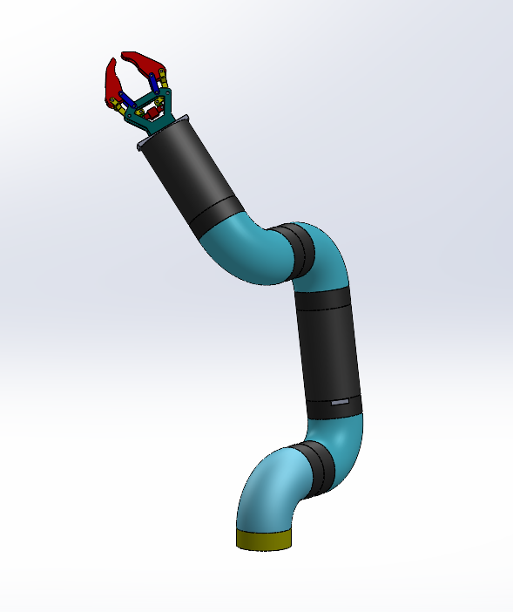
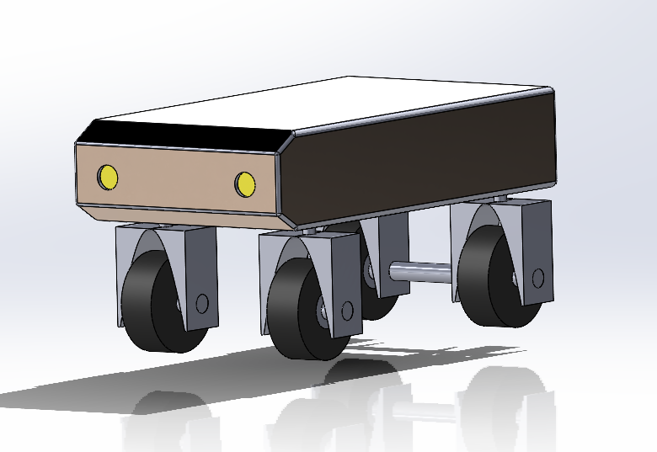
CAD models

Slide 7
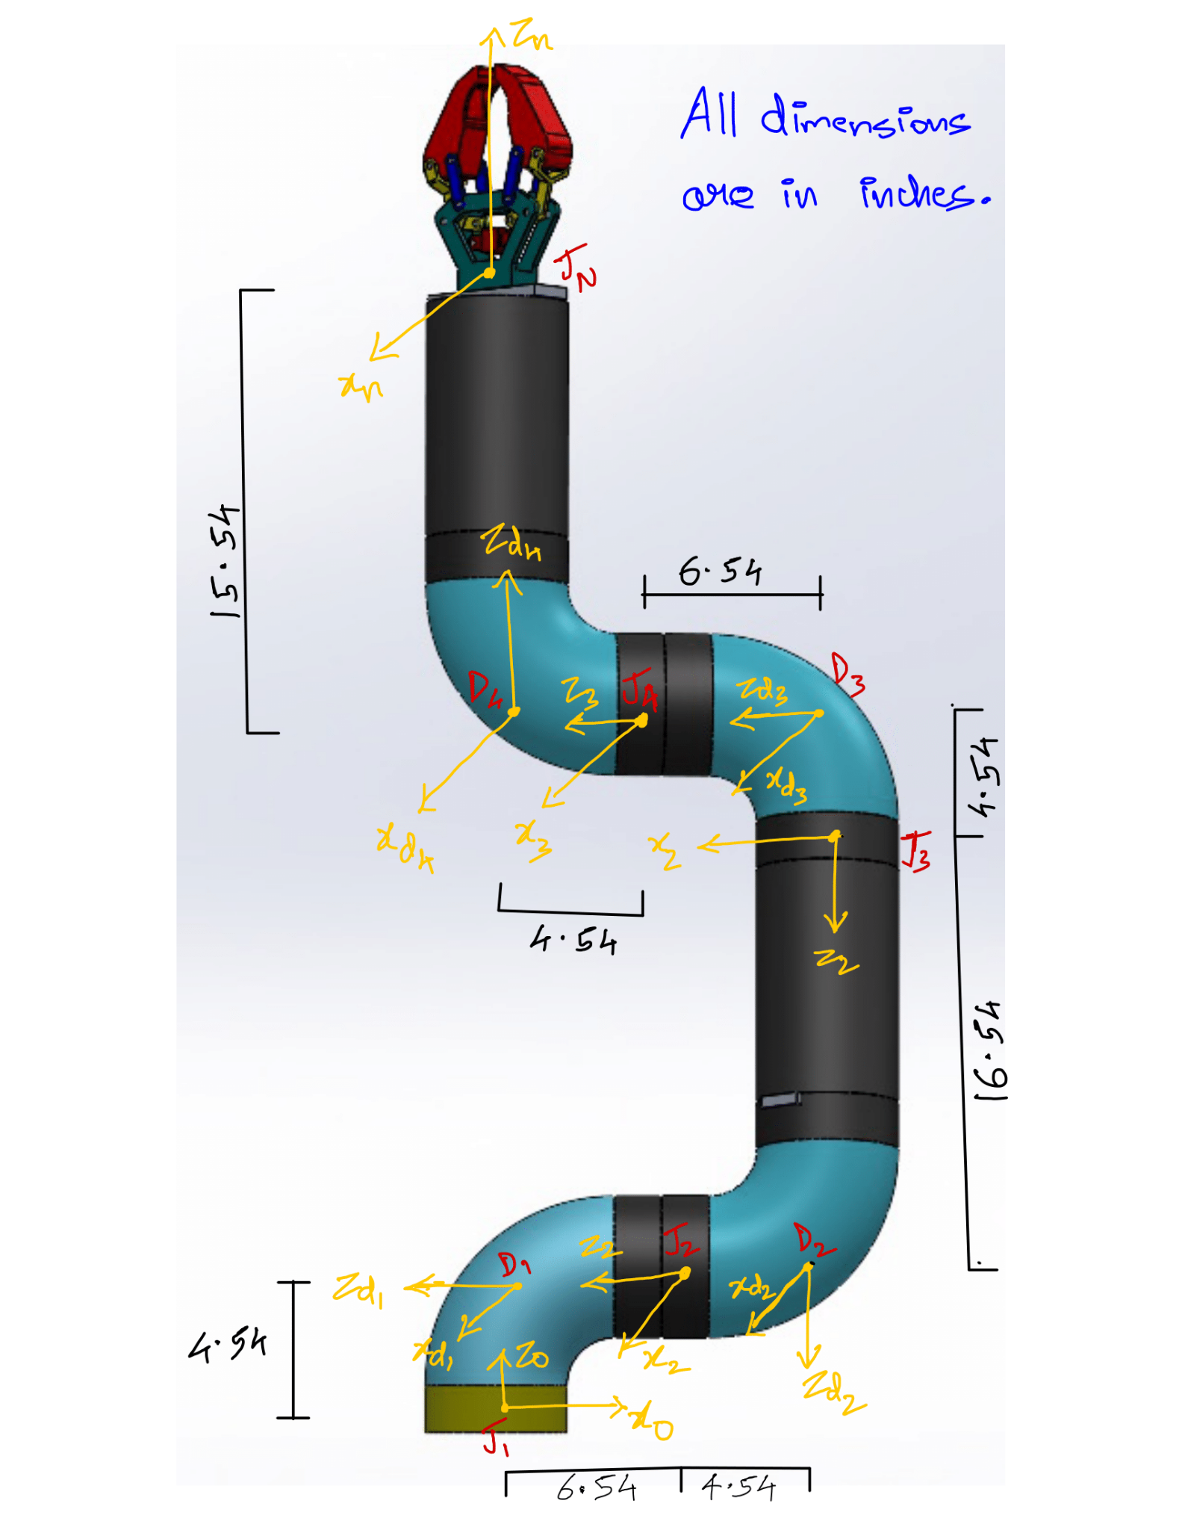
DH Frames and Table

Slide 8
Joints | α | d | a | Θ
J1 | 90 | 4.54 | 0 | -90
D1 | 0 | -6.54 | 0 | 0
J2 | 90 | -4.54 | 0 | Θ(2)
D2 | 0 | -16.54 | 0 | 90
J3 | -90 | -4.54 | 0 | Θ(3)-90
D3 | 0 | 6.54 | 0 | 0
J4 | -90 | 4.54 | 0 | Θ(4)
D4 | 0 | 15.54 | 0 | 0

Slide 9
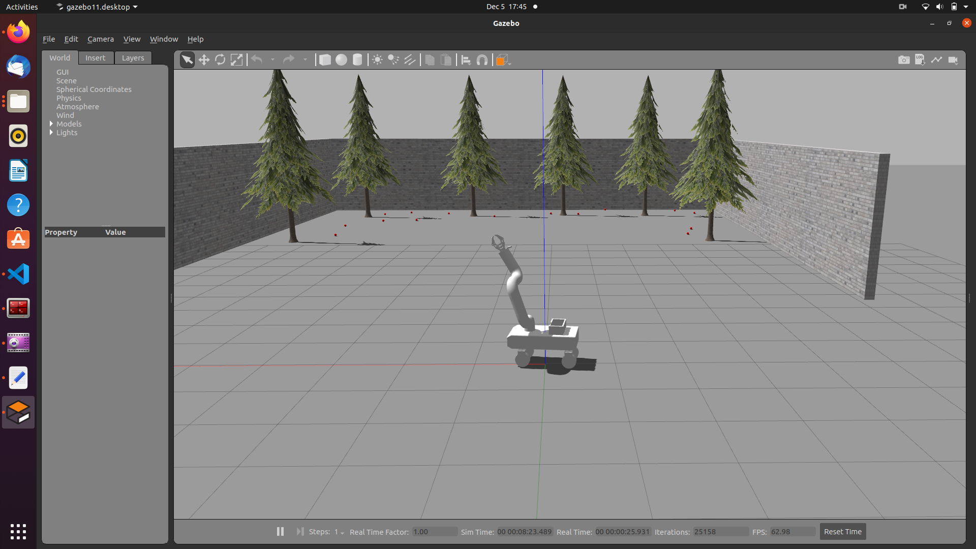

Slide 10
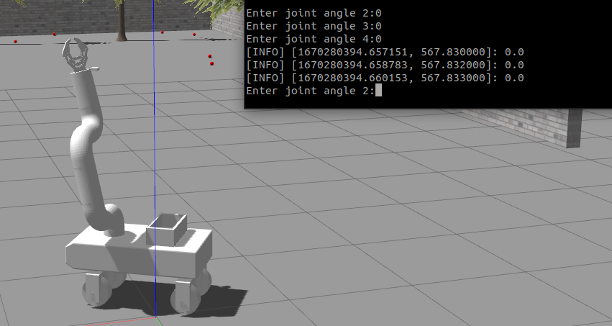
Forward and Inverse Kinematics Calculation and Verification
J1 = 0° | J2 =0° | J3 = 0°

Slide 11
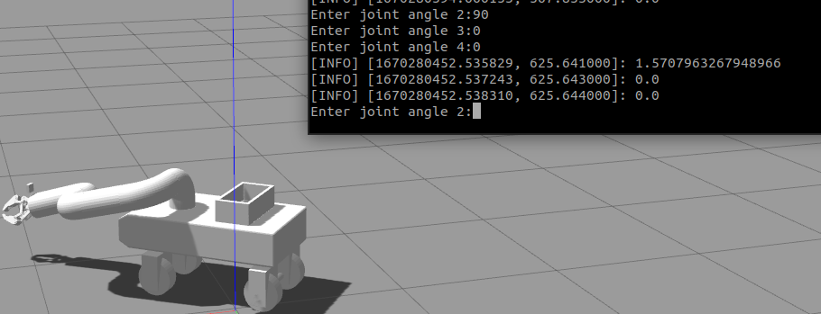
J1 = 90° | J2 =0° | J3 = 0°

Slide 12
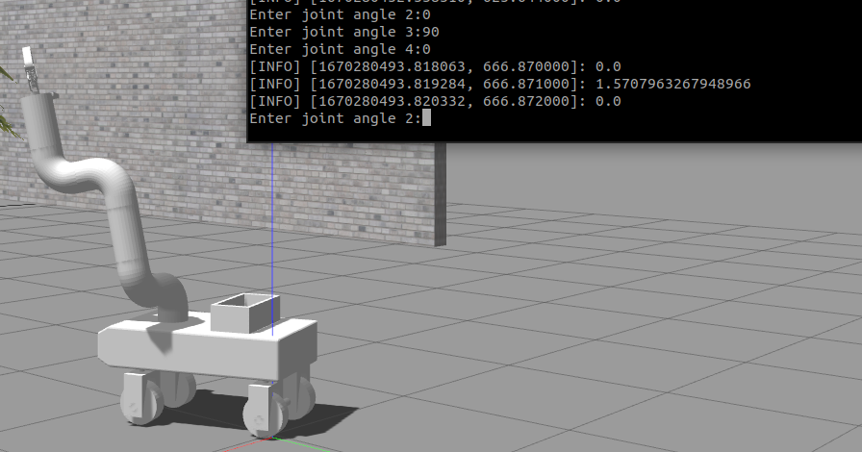
J1 = 0° | J2 =90° | J3 = 0°

Slide 13
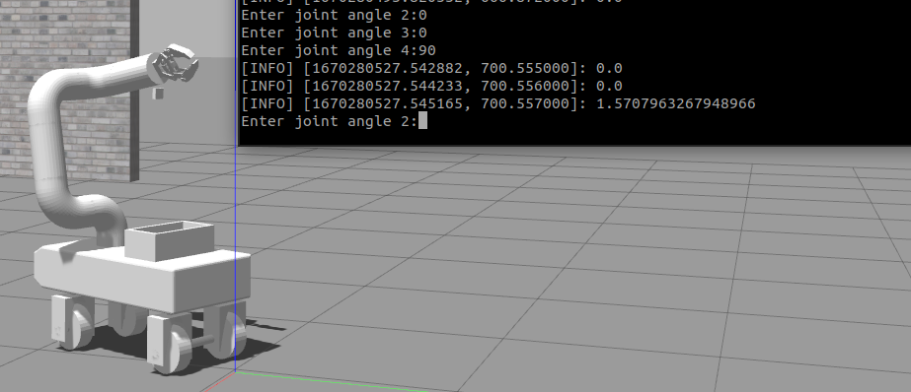
J1 = 0° | J2 =0° | J3 = 90°

Slide 14
Simulation
Link to drive

Slide 15
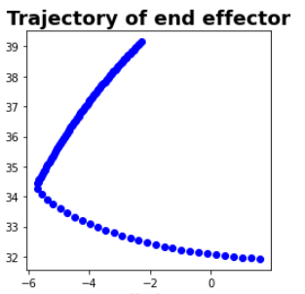
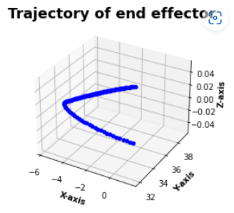
Results
The trajectory of pick pose is modelled below:

Slide 16
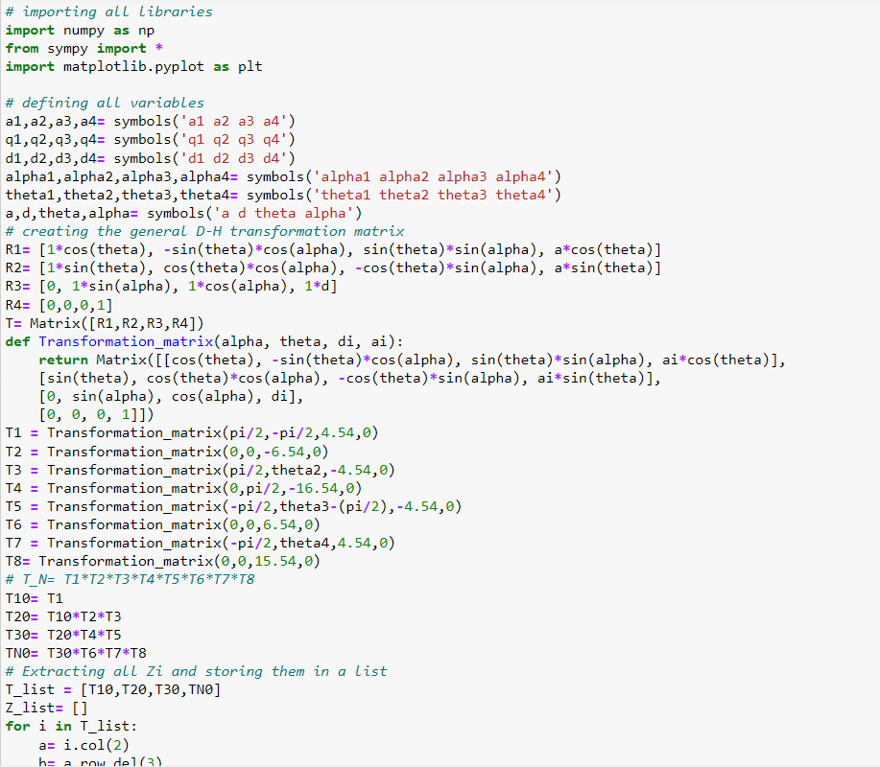
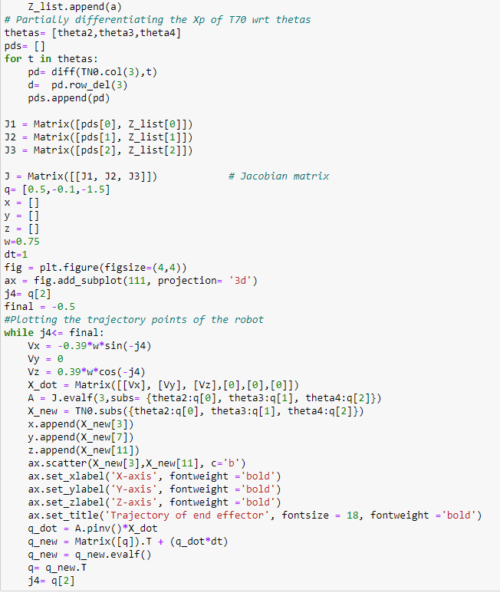
Code

Slide 17
Conclusion
Successful implementation of GoodPick that can teleop to the required position and scan the object using camera sensor before picking it up using the attached end-effector gripper.
The Forward and Inverse kinematics were verified using the robot poses and the trajectory plotted by the end-effector.
The gazebo world was created according to the application environment of our robot.

Slide 18
Challenges Faced
The gazebo simulator didn’t provided us the opportunity to fix fruits on top of tree in contrast with Copeliasim.
We faced issues while configuring our manipulator in MoveIt as there were issues associated with the moveit launch file in the Gazebo world. The robot did spawn in Rviz but not in Gazebo.
The PID tuning was very difficult as the weight and inertial components impacted the movement of the manipulator very heavily.

Slide 19
Contributions
Robot Modeling and assembly along with URDF file- Hritvik
Forward and Inverse Kinematic validation using DH parameters- Hritvik
Attaching controllers and PID tuning for joints- Abhimanyu
Creating Gazebo world, Pub-Sub architecture and camera sensor integration- Abhimanyu
Presentation and report- Hritvik and Abhimanyu

